Slide 1
Deep Joint Entity Disambiguation with Local Neural Attention
Octavian-Eugen Ganea, Thomas Hofmann
ETH Zurich
EMNLP 2017

Slide 2
Overview
Document-level entity disambiguation
Attention model for local context
Loopy belief propagantion for global entity disambiguation
Notes:
本文的目标为提供一种在文档层面实体消歧的方法
一般的实体消歧在局部层面和全局层面两个层次做，在局部上下文层面使用纯注意力模型
在全局上下文消歧中使用循环置信传播的方法来完成

Slide 3
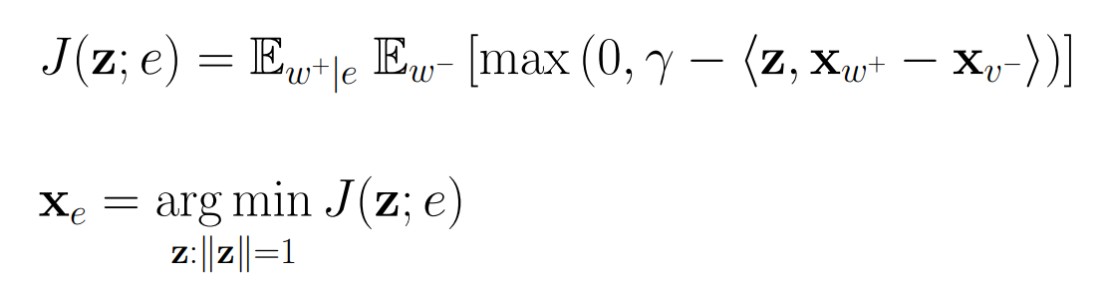
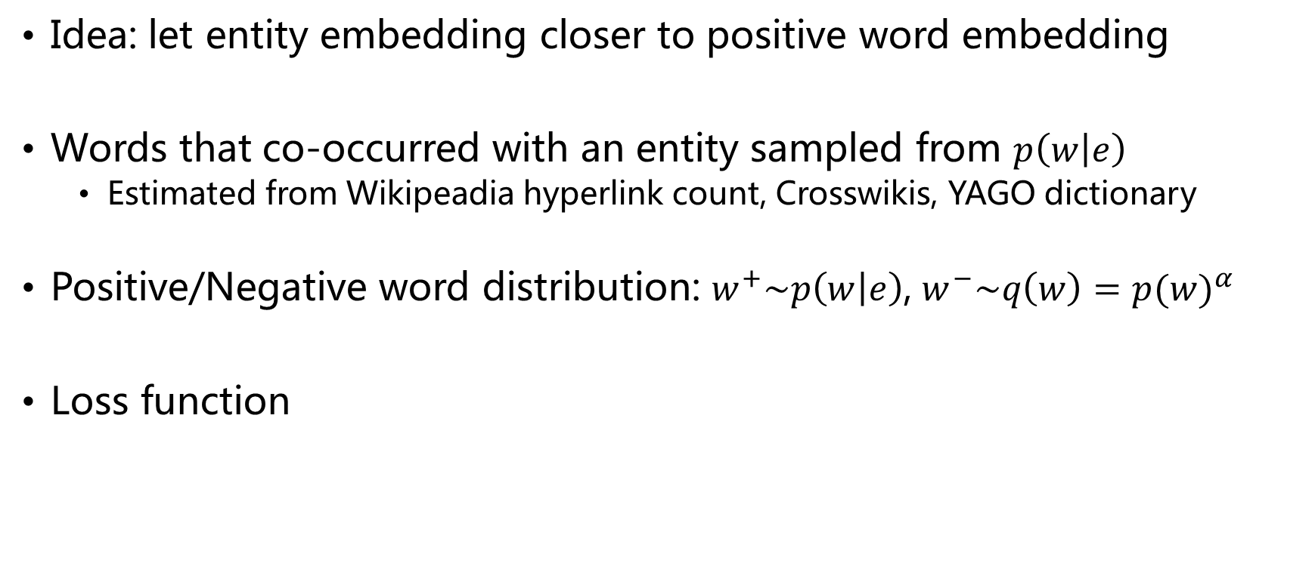
Learning Entity Embedding
Idea: let entity embedding closer to positive word embedding
Words that co-occurred with an entity sampled from $p\left(w | e\right)$
Estimated from Wikipeadia hyperlink count, Crosswikis, YAGO dictionary
Positive/Negative word distribution: $w^{+}\sim p\left(w | e\right)$, $w^{−}\sim q\left(w\right)={p(w)}^{α}$
Loss function
Notes:
首先需要快速学习得到实体的向量表示
训练的思想是将实体的向量转化到单词的向量里，使得实体和正样本的词向量接近
使用hinge loss，让正负样本间的得分尽量拉开，此外对于实体的向量表示要做归一化

Slide 4
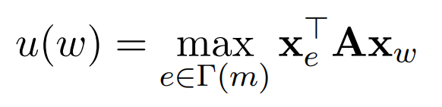
Local Model with Neural Attention
Goal: Compute a score between candidate entities and context
For each mention, compute a pruned candidate entities set with S entities
For all context word surrounding mention, compute a support score for each candidate entity(A is a parameterized diagonal matrix)

Slide 5

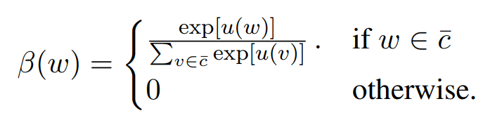
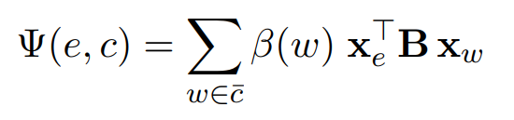
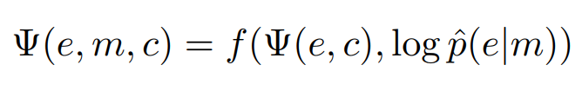
Local Model with Neural Attention
Hard prune to the top R ≤ K words with the highest score
Attention weights
Final weighted context-based entity-mention score
Final local model

Slide 6
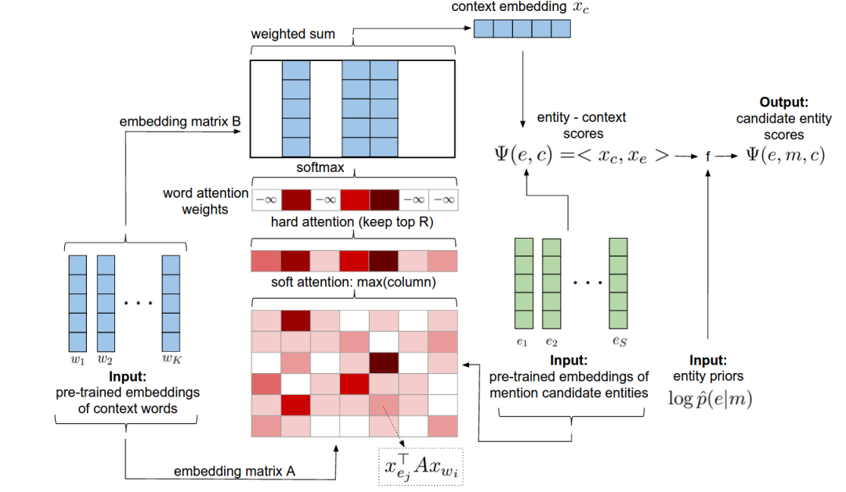
Local Model with Neural Attention

Slide 7
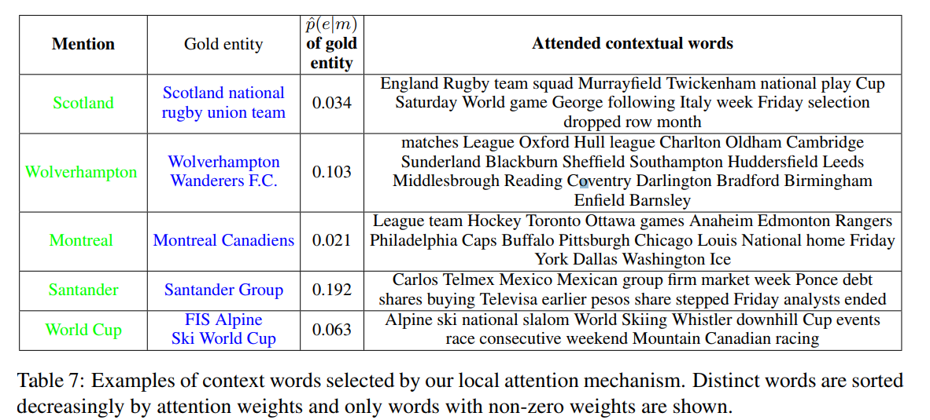
Local Model with Neural Attention
fds
Notes:
这个例子用来展示在上下文中与实体相关性较高的词

Slide 8
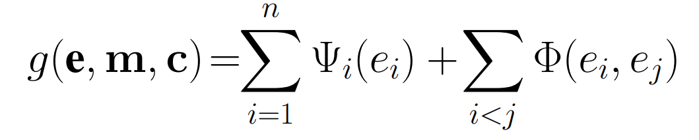
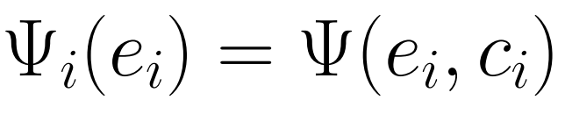
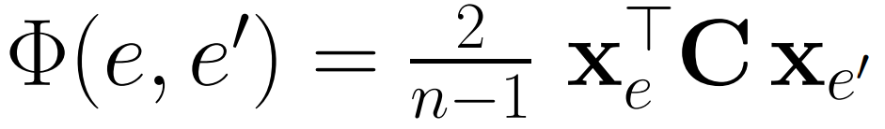
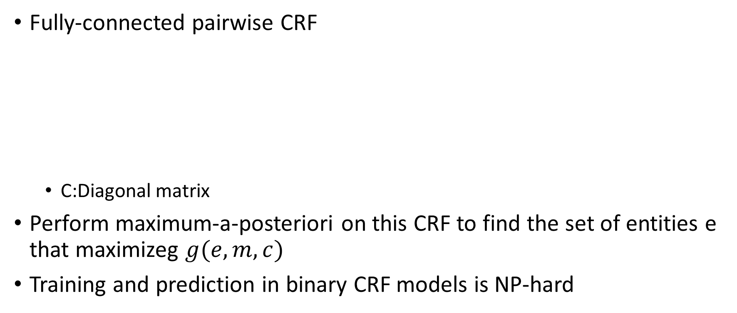
Deep Model for Global ED
Fully-connected pairwise CRF
C:Diagonal matrix
Perform maximum-a-posteriori on this CRF to find the set of entities e that maximizeg $g(e,m,c)$
Training and prediction in binary CRF models is NP-hard
Notes:
这一步是要在文档层面（全局）来处理实体消歧
将模型看作一个pairwise的条件随机场
两部分：第一部分就是刚才提到的局部上下文模型，第二部分为全局上下文模型，形式上为两个实体相似度得分，做归一化
我们的目标就是选出一组实体使得g(e,m,c)最大

Slide 9
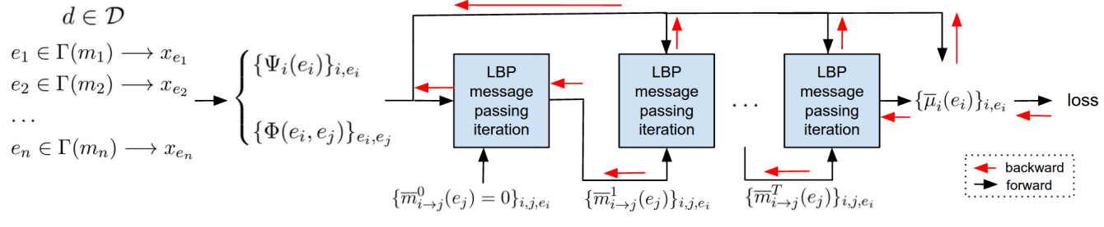
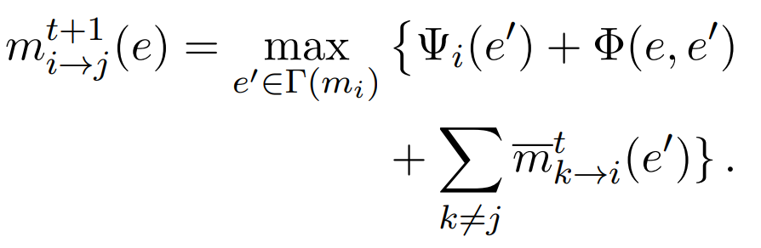
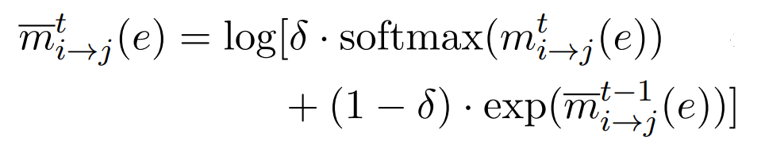
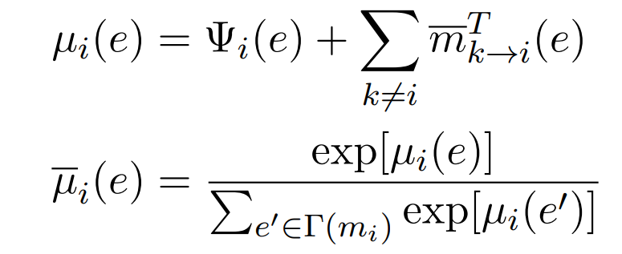
Loopy Belief Propagation
A neural network with T layers encodes T message passing iterations of synchronous max-product LBP.
After T iteration(T network layers)，
the belief(marginals) are computed as：
Notes:
使用循环置信转播来解决此问题
迭代方法为每一步mention i中的候选实体向 mention j投票，第一部分就是CRF的potential，第二部分为投票者在本次迭代中与上次迭代中获得投票的加权平均
看成神经网络
信念计算为

Slide 10
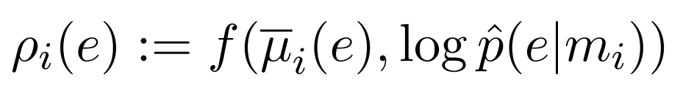
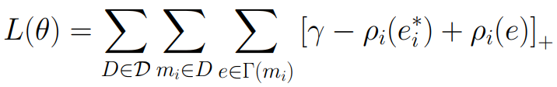
Loopy Belief Propagation
Approximate LBP marginals combined with the mention prior
Training loss
Notes:
和局部模型使用同一个非线性函数f来计算最终的概率
训练的时候使用hinge loss作为损失函数

Slide 11
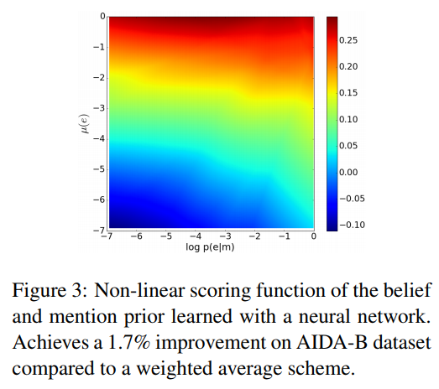
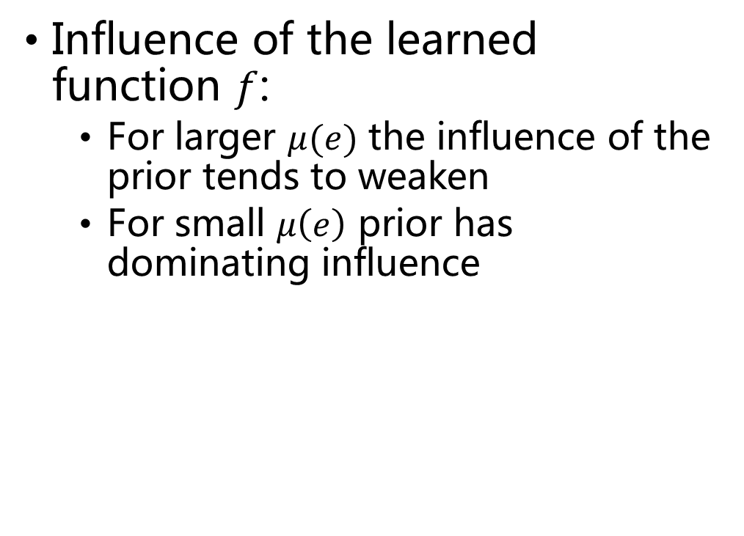
Deep Model for Global ED
Influence of the learned function $f$:
For larger $μ(e)$ the influence of the prior tends to weaken
For small $μ\left(e\right)$ prior has dominating influence

Slide 12
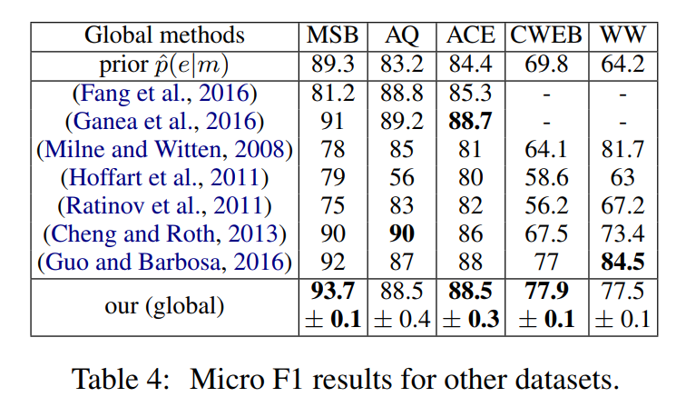
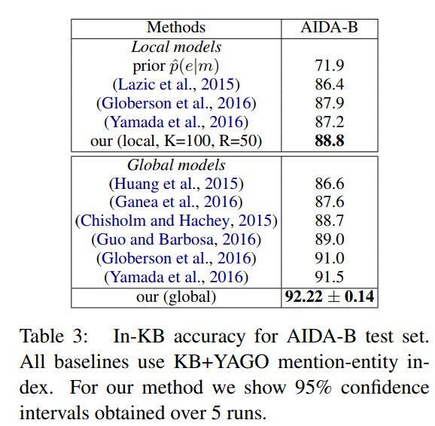
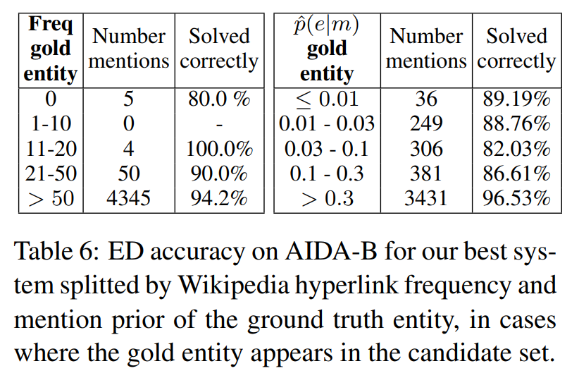
Experiment
Df

Slide 13
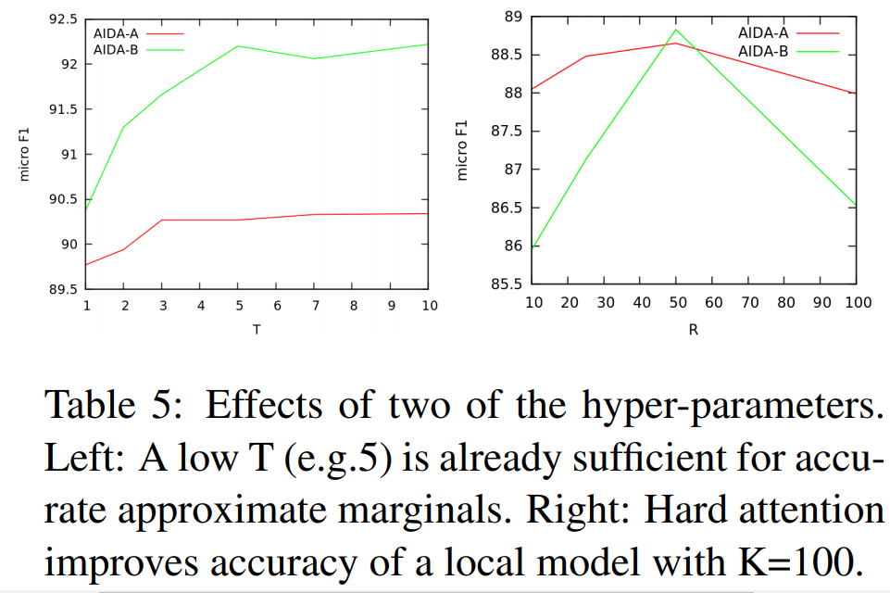
Experiment

